Slide 1


TypeScript Basic
Prepared By: Shrish Tripathi

Slide 2
Golden Line
I never loose…either I win or I learn

Slide 3
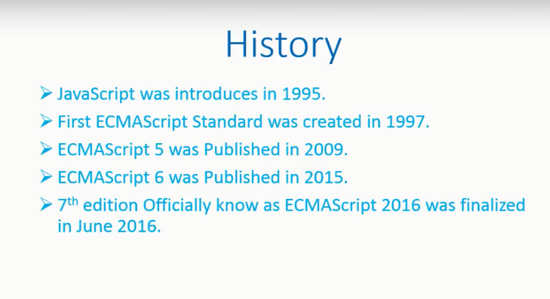

Slide 4
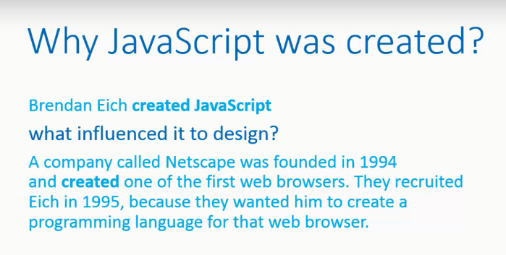

Slide 5
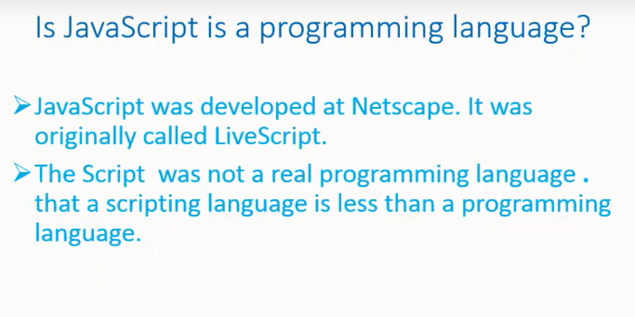

Slide 6
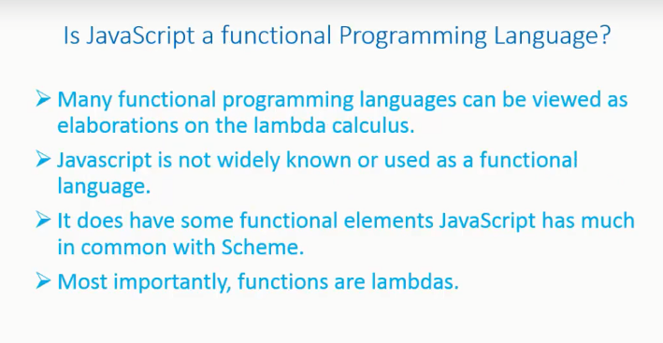

Slide 7


Slide 8
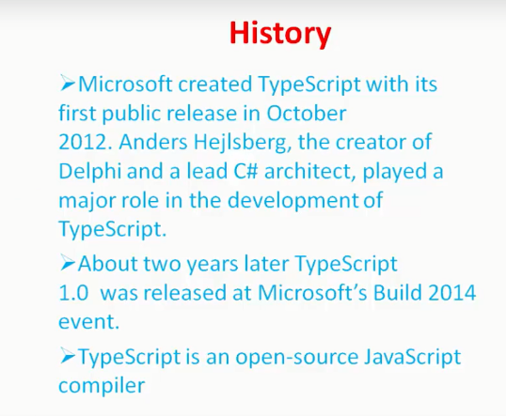

Slide 9
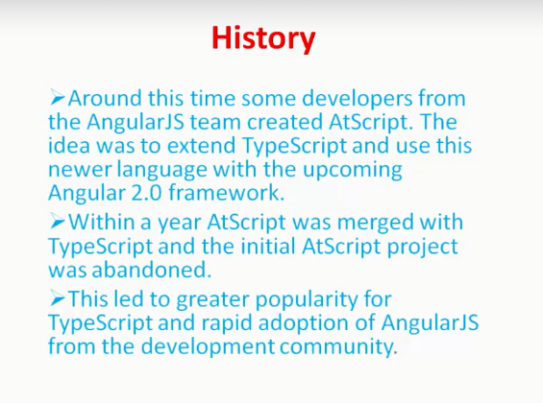

Slide 10
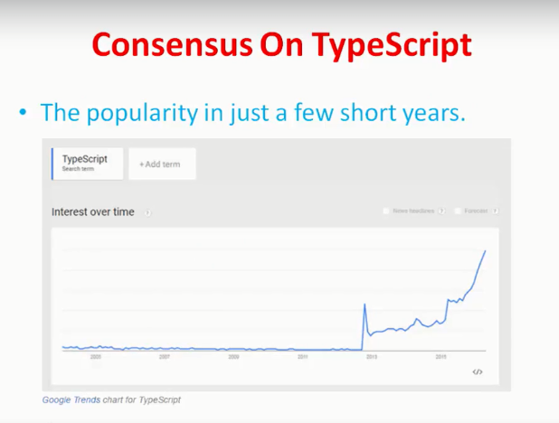

Slide 11
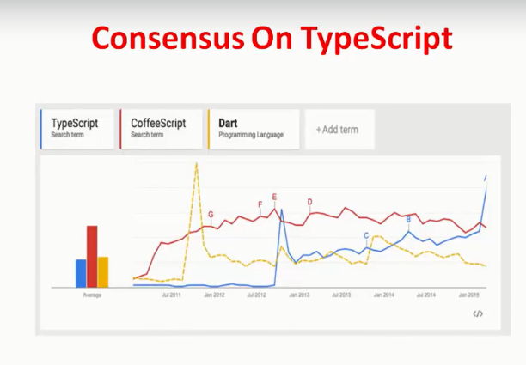

Slide 12
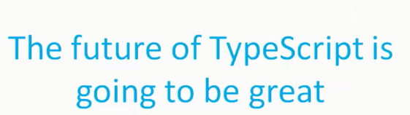

Slide 13
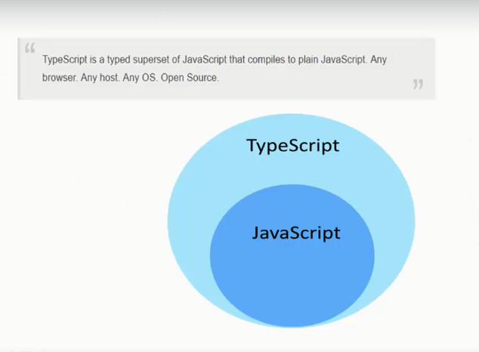

Slide 14
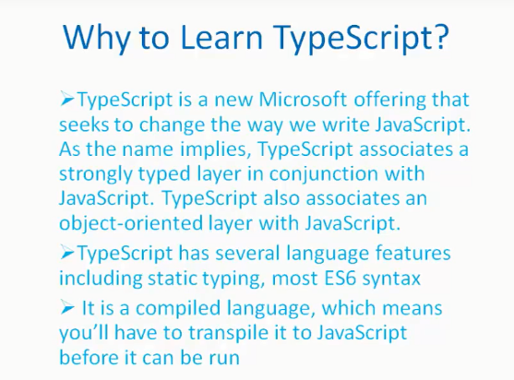

Slide 15
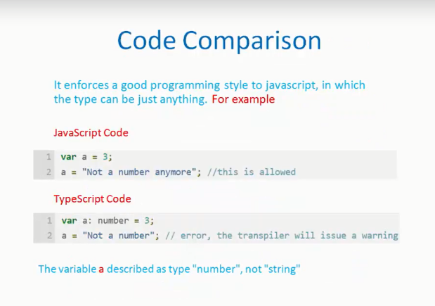

Slide 16
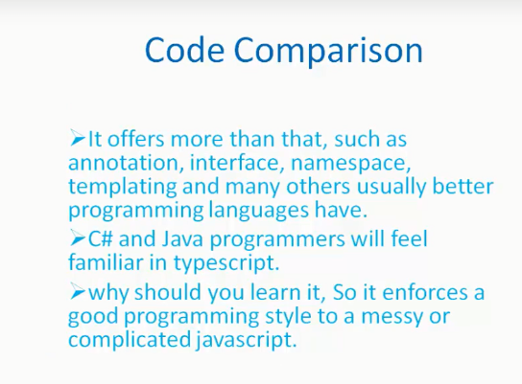

Slide 17
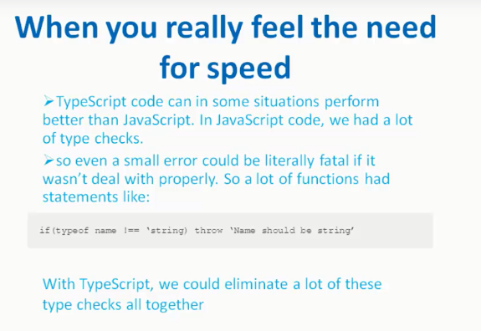

Slide 18
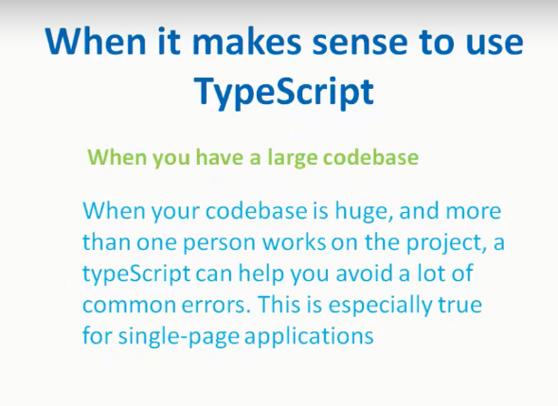

Slide 19
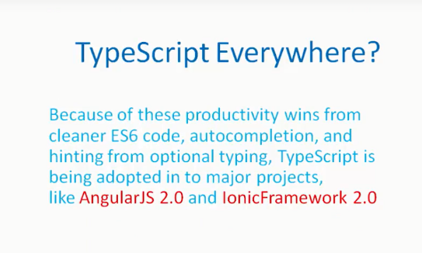

Slide 20
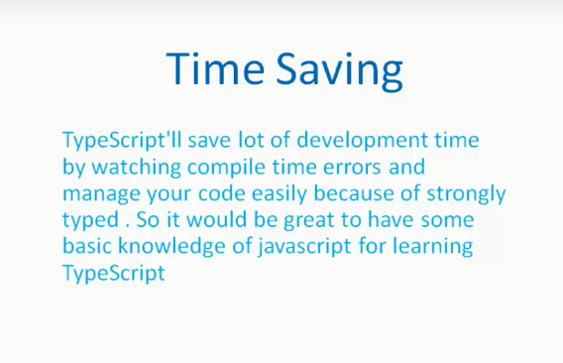

Slide 21
Time for Action !!

Slide 22
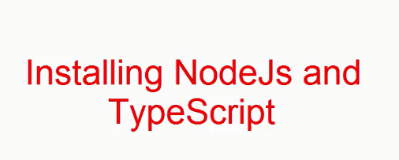

Slide 23

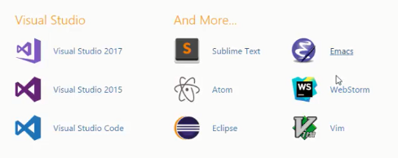

Slide 24
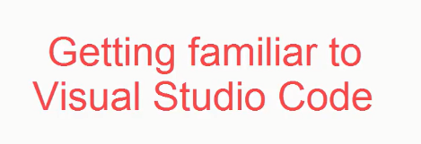

Slide 25
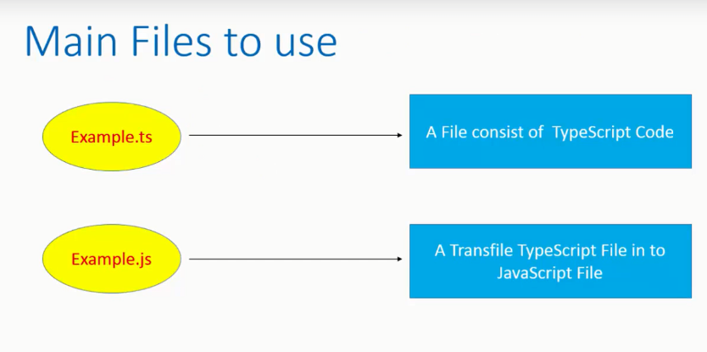

Slide 26
Let us start with the traditional “Hello World” example ☺
var message:string = "Hello World"
console.log(message)

Slide 27
Data Type
Boolean
String
Number
Array
Enum
Tuple
Refer Code file for sample example

Slide 28
Operator
Arithmetic operators
Logical operators
Relational operators
Assignment operators
Ternary/conditional operator
String operator
Type Operator
Refer Code file for sample example

Slide 29
Decision making
If
If… else
switch
Refer Code file for sample example

Slide 30
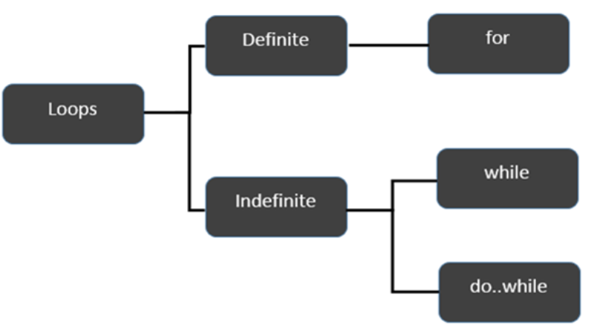
Loop
for
while
Do..while
Refer Code file for sample example

Slide 31
QUIZ

Slide 32





Slide 33
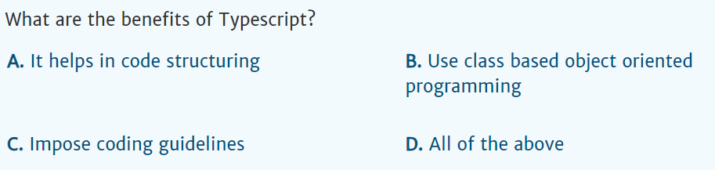

Slide 34
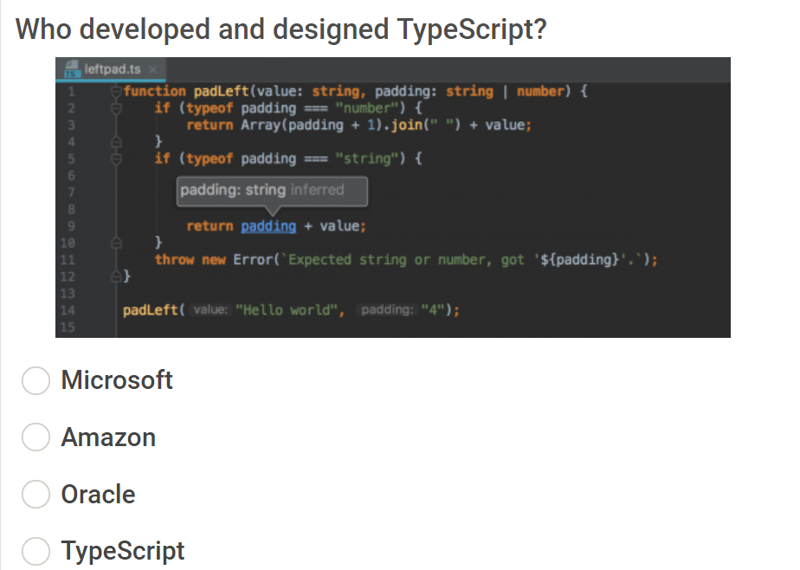

Slide 35
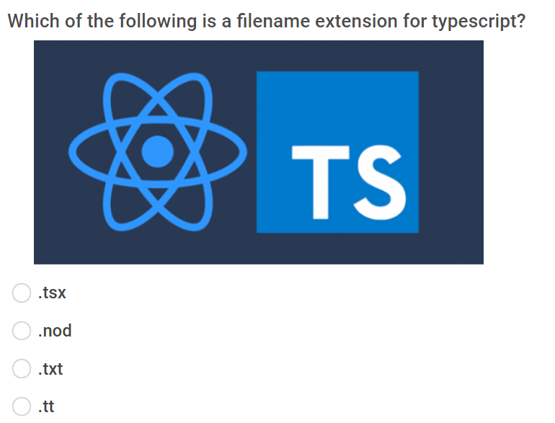

Slide 36
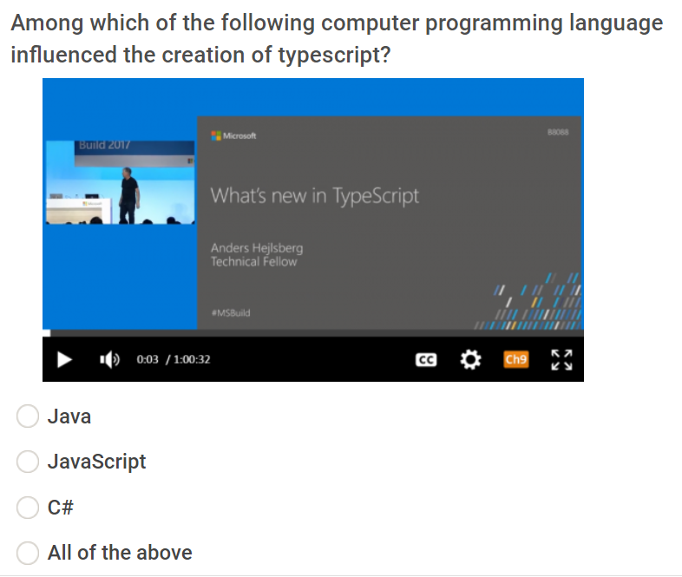

Slide 37
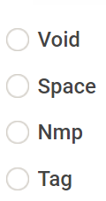

Slide 38
Which one is correct syntax for “ for loop”
for(i = 0;i>=1;i--)
for(i = 0;i>=1;)
for(i>=1;i--; i= 0)
for(i = 0;i>=1;i++)

Slide 39
Which one is correct syntax for “ while loop”
1) while(condition) {
// statements if the condition is true
}
2) while(condition) {
// statements if the condition is false
}
3) while[condition] {
// statements if the condition is true
}
4) while {
//(condition)
}

Slide 40
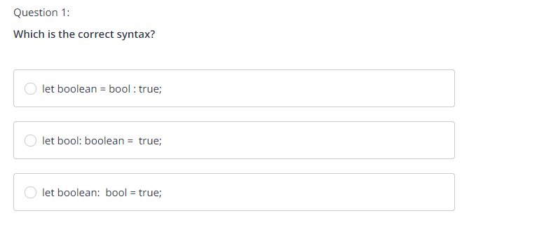
QUIZ-Data Types

Slide 41
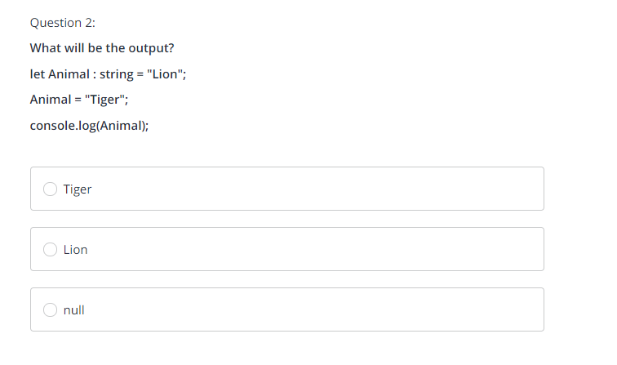

Slide 42
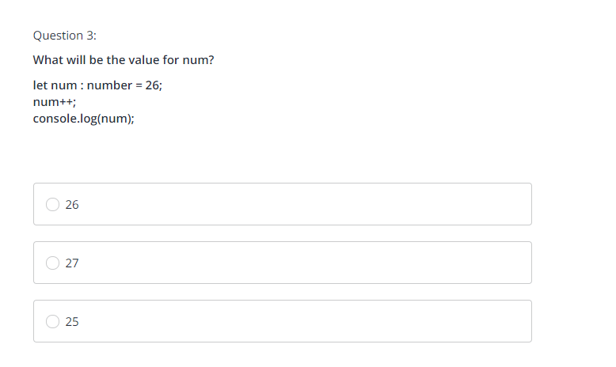

Slide 43
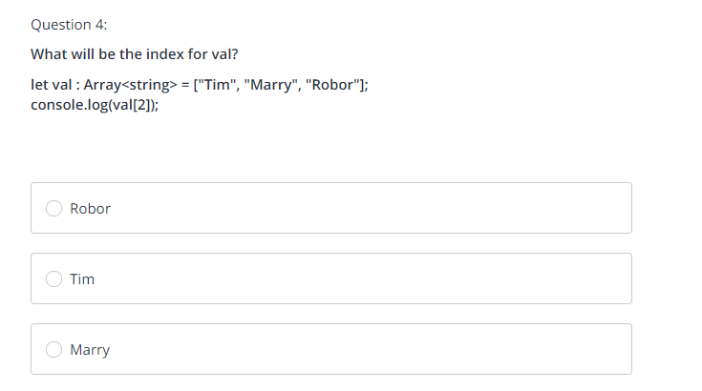

Slide 44
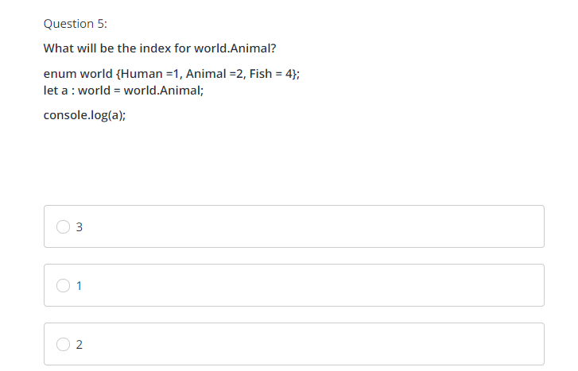

Slide 45
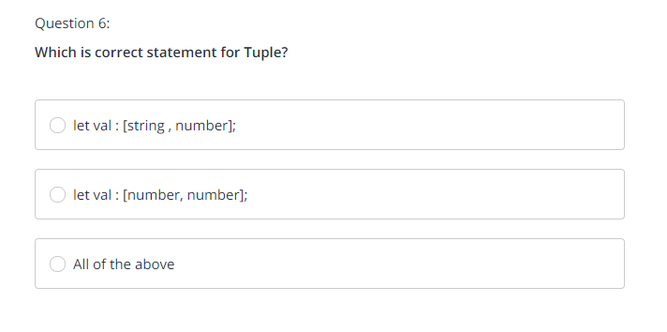

Slide 46
